Slide 1
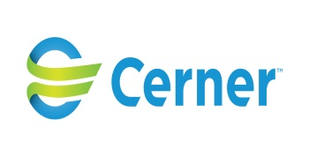
Health Information Technology: Leading the Way to Healthcare Innovation
Presented to Washington University IDEA Labs conference, St. Louis, Sept. 27, 2014 by
Bob Harmon, MD, MPH, Physician Executive, Cerner Corp

Slide 2
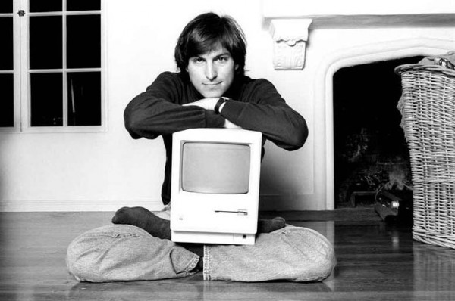
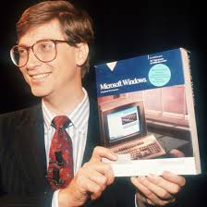
Role models
Notes:
Steve Jobs
Mac and iPad
iTunes and iPod
Pixar
iPhone
Bill Gates
MS DOS, Windows, Office, etc
Gates Foundation
Story of meeting him at United Way event in Wash DC area
Who will revolutionize health care?

Slide 3







Health care is too important
to stay the same.
TM
Notes:
Nice to be back at WU
Audience poll
Recognize Paul Gamble
Impressed by medical campus growth and especially glad to hear about the progress of the Institute for Public Health
How I ended up as a preventive medicine and health IT guy

Slide 4
What I’ll be talking about…
Why we’re here
Consumer and clinician needs/wants
Population health
Health informatics
Priority targets for innovation in health and health care
Comments & questions

Slide 5




Cerner At-A-Glance
15,000+ Associates
21% Development
13% Clinicians
10% Managed Services
Solutions licensed
at 10,000 sites in
24 countries
Cumulative R&D
exceeds $3.8B
13
$1.85B
2010
47
79
#
#
#
#
Google
Apple
$251K
1980
$186.9M
1995
Worlds Most Innovative Companies
2013 revenues
of $2.9B
2013
Notes:
Cerner is pleased to be a co-sponsor of this event.
Recognize Jennifer Cary from HR at table. She’ll be answering your questions about Cerner jobs, rotations, externships, etc.
I’m enjoying being one of more than 1,900 health professionals who work in many parts of the company, from development to sales to implementation and consulting.
There are thousands of health IT companies ranging from startups to large ones like Cerner. Plenty of opportunities for you to find a place to pursue your ideas.

Slide 6
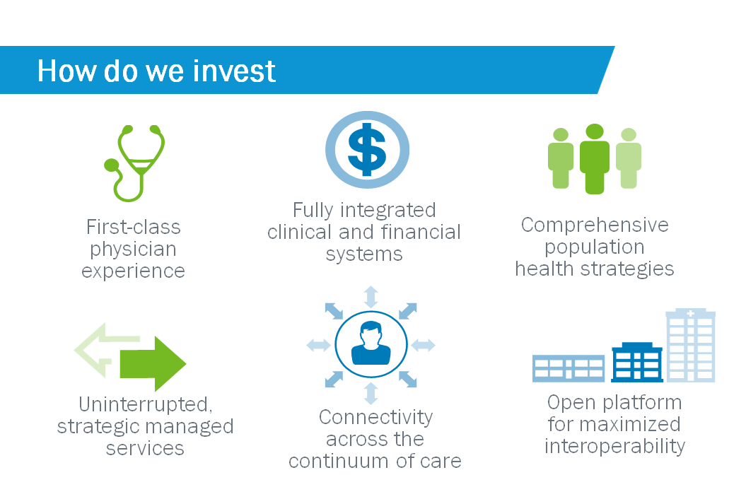

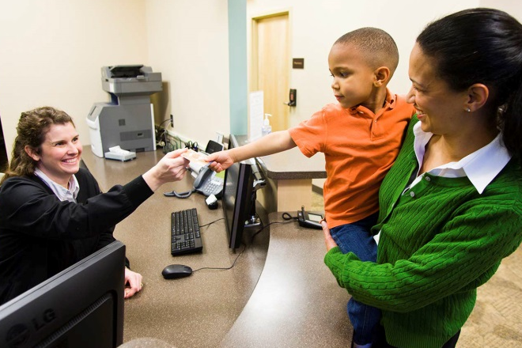


Cerner Focus
Health care is personal. That is why Cerner is focused on:
Providing easy-to-use solutions so you can focus on delivering the highest levels of quality care
Deliver a predictable implementation and realization of Value through HCIT solutions
Enabling healthy populations to advance people’s quality of life
Notes:
Here are Cerner’s priorities for innovation and investment
We are interested in automating the entire continuum of care through both our own solutions and with partners.
Some of our growth has been through acquisitions, such as the one currently in progress with Siemens HIT unit
The inventions you create may someday be connected in some way to a Cerner solution.

Slide 7
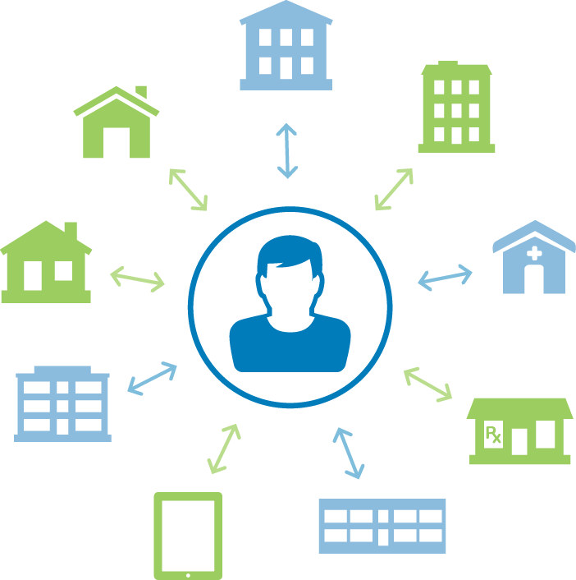
Person-Centered Architecture
Public Health
Rehab
Lab
Supporting
care across the
continuum
Home
Ambulatory Care
Hospital
Pharmacy
Extended Care Facility
Remote Access
Notes:
We believe the individual patient, customer, or member should be at the center of everything we do, including the EHR.
I hope you will keep that in mind with your innovations.
HIT presents innovation opportunities across the continuum of care, including devices, mobility, and yet to be invented solutions.

Slide 8

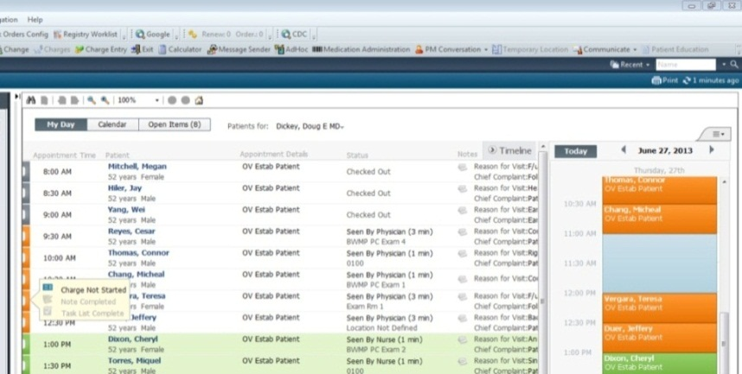
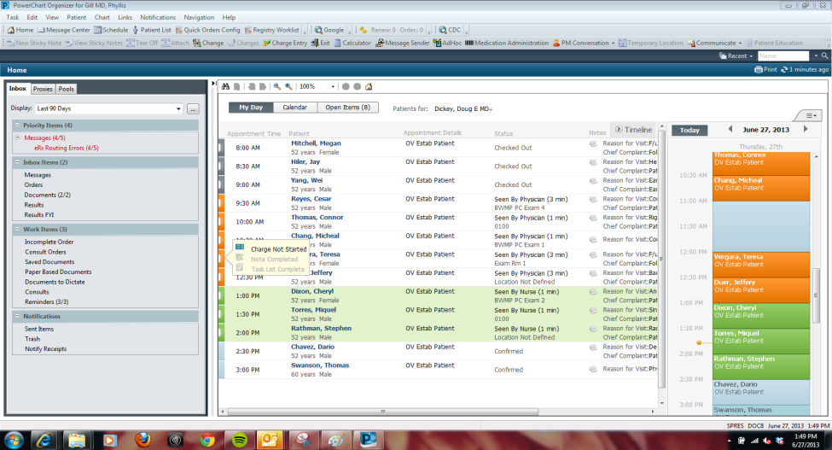

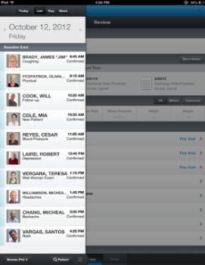
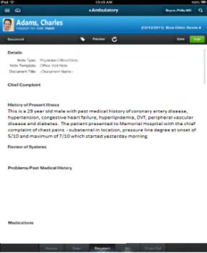
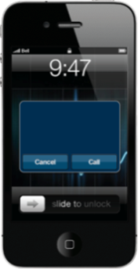
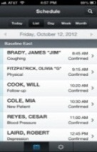

A First-Class Clinician Experience
Fast, easy and smart across devices.
Award-winning user experience.
Notes:
Devices such as tablet computers and smartphones are rapidly being adapted for clinician and patient use.
Many innovation ideas are being implemented, often coming from EHR users.
You can be the source of the next great idea!

Slide 9
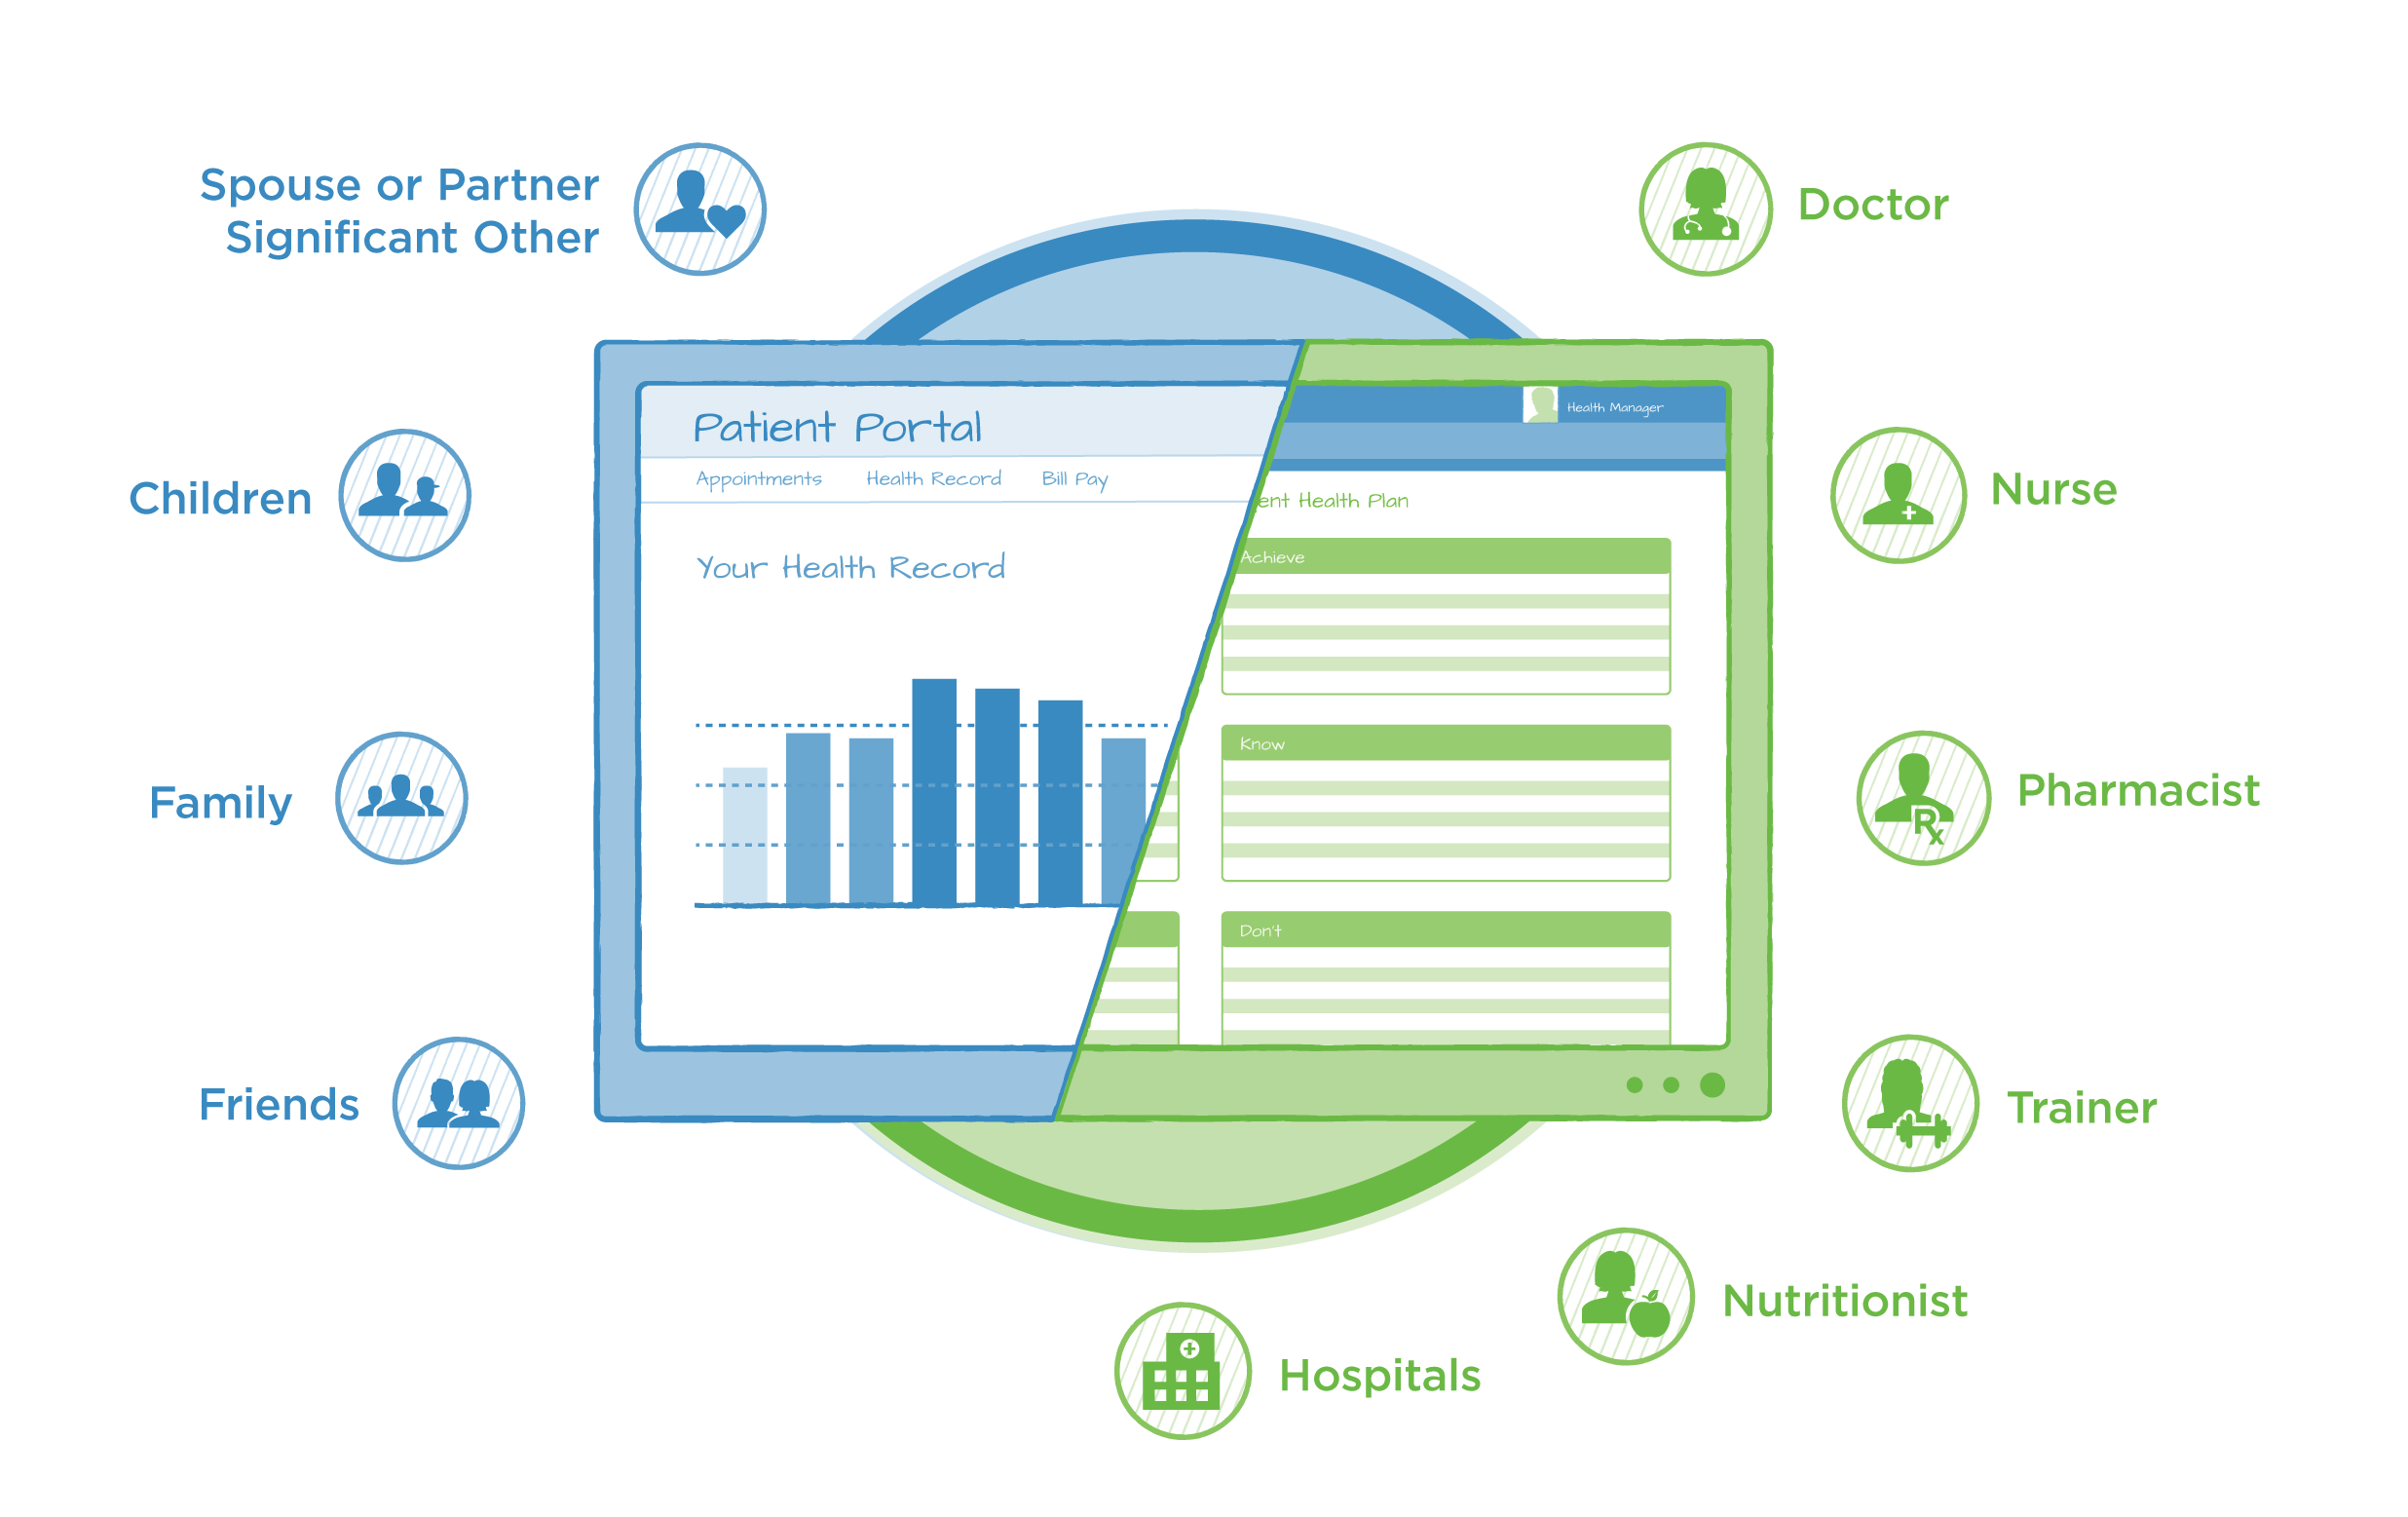


Engage … patients in a personalized way
We provide solutions
to help individuals:
Access their health information
Connect with their
care team
Engage in their health

Slide 10
Source:Healthy People: The Surgeon General's Report on Health Promotion
and Disease Prevention (1979), page 1-9.
Notes:
But what about priorities?
What will be the impact of my invention on population health?
This pie chart shows what impacts how long we live.
Note that our medical and surgical interventions are often late in the disease process and don’t have as much impact on mortality as we think. Primary, secondary and tertiary prevention are often better solutions to prolong a healthy life.

Slide 11
Official Causes of Death (CDC, 2007)
# of deaths
Heart Disease ……..……………………..…….
Malignant Neoplasm ………………………….
Cerebrovascular Diseases …………………..
Chronic Lower Respiratory Diseases ……..
Accidents (Unintentional Injuries) ………….
Alzheimer’s Disease …………………………..
Diabetes mellitus ………………………………
Influenza and Pneumonia …………………….
616,067
562,875
135,952
127,924
123,706
74,632
72,432
56,326
Notes:
These are the causes that appear on death certificates.

Slide 12
Real Causes of Death
(Mokdad, et al, 2004)
# of Deaths
Tobacco ………………………………………….
Poor Diet and Physical Inactivity …….
Alcohol Consumption …………………. ...
Microbial Agents …………………………….
Toxic Agents ……………………………………
Motor Vehicle …………………………………
Firearms …………………………………….….
Sexual Behavior ……………………………..
Illicit Drug Use ………………………….......
435,000
365,000
85,000
75,000
55,000
43,000
29,000
20,000
17,000
Notes:
These are the real underlying causes..
Note that many are preventable and related to lifestyle and behavioral factors.
How will your inventions impact these?

Slide 13
Strategy for Population Health
Know
and understand your population
Engage
members, families and
their care team
Manage
outcomes
Notes:
As we shift from a volume-driven health care system to a value-driven one, keeping healthy people healthy and helping those in need receive timely care in the appropriate venue, will be key.
To best manage this, you need the capability to identify populations based on a set of criteria and predict the behaviors of that population. Once you’ve identified your populations, you’ll need the ability to effectively engage your members, their families and their care team in a personal way. When you have the ability to personally engage individuals in your population, and the people who care for them, you’re better able to promote health, achieve compliance, and provide interventions before its too late.
When you do these things, better outcomes happen as you’re able to continually improve the care you provide.
We can help you manage the health of your population, improving outcomes and lowering costs, with the most comprehensive set of solutions and strategies available.

Slide 14





Data Aggregation and Transformation
Consumer, claims, clinical, wellness, satisfaction, cost, other
Population Surveillance/Identification
Identify, score, predict, stratify population
KNOW
Low risk
Moderate risk
High risk
Build & Deploy Programs
Campaign/Enroll/Action
Attribute and push personalized interventions & actions through the Programmable Network
Health
promotion wellness
Health risk management
Care coordination/
advocacy
Disease/case management
ENGAGE
Refine
Care coordinator
Programmable Health Network
Peer coach
Providers
Person
Monitor Programs
MANAGE
Risk
Provider
network
Payer
network
Performance/
Incentives
Programs
Financial outcomes
Clinical, health outcomes

Slide 15
Clinical informatics
New specialty and growth area in health care
Involves the intersection of data and computer systems
Courses and certification available to many health professions at many universities
New medical board subspecialty exam now available
Large hospital systems and other organizations are now hiring chief medical and nursing informatics officers

Slide 16
Suggestions for innovation
  Tools to improve patient participation, experience, adherence and compliance
  Tools to make clinical practice smarter, faster and easier
  Ways to lower the price of health care
  Ways to improve health outcomes and population health

Slide 17

Preparing for
tomorrow’s reality
starts now.
Notes:
Your ability to achieve better care at lower costs, will determine your success in the future.

Slide 18



Together we can accomplish
great things.

Slide 19
Questions or comments?
bob.harmon@cerner.com

Slide 20
Reference slides…

Slide 21


CERNER POPULATION HEALTH MANAGEMENT
 | KNOW The Population |  | ENGAGE Members |  | MANAGE Outcomes
 | Care Venue Automation Electronic Health Record Cerner Millennium Data Exchange Cerner Exchange Cerner Network Longitudinal Record HealtheRecord Enterprise Analytics & Reporting Data Analytics HealtheAnalytics PowerInsight Explorer Data Warehouse HealtheEDW PowerInsight EDW (outside U.S. only) Quality & Regulatory Reporting Ambulatory Physician Quality Reporting Core Measures w/ eQualityCheck |  | Member Engagement Personal Health Portals HealtheLife Cerner Wellness Portal Community-Based Care Sports Medicine HealtheAthlete Care Management HealtheCare Home Care HomeWorks, RoadNotes Home & Community Care Long-Term Care CareTracker, PowerChart LTC, MDS Intelligence Retail Pharmacy Pharmacy Management System |  | Capacity & Workforce Mgmt Capacity Management CareAware, CareAware Patient Flow, CareAware Tracking Workforce Management Assignment Manager, Staff Manager, Demand Manager, Patient Progress Manager, Physician Scheduler, Shift Alert Clinical Programs & Outcomes Clinical Research Discovere, Health Facts, HealthSentry, i2b2, PowerTrials Performance Improvement Diabetes Management, Heart Failure, Infection Control, IPOC, Palliative Care, Patient Blood Management, Readmission Prevention, Rapid Response Team, Sepsis Prevention, Transitions of Care, VTE Prevention Predictive Modeling Readmission, Sepsis Registries & Scorecards HealtheRegistries Financial Management Revenue Cycle Case Management, Health Information Management, Patient Access, Patient Accounting, Practice Management Contract Management HealtheManagement: Contracts Network Management Provider Network Management HealtheManagement: Provider Network
 |  | REFINE
TABLE KEY: nAvailable Solutions n Planned for 2014 n Future Development

Slide 22
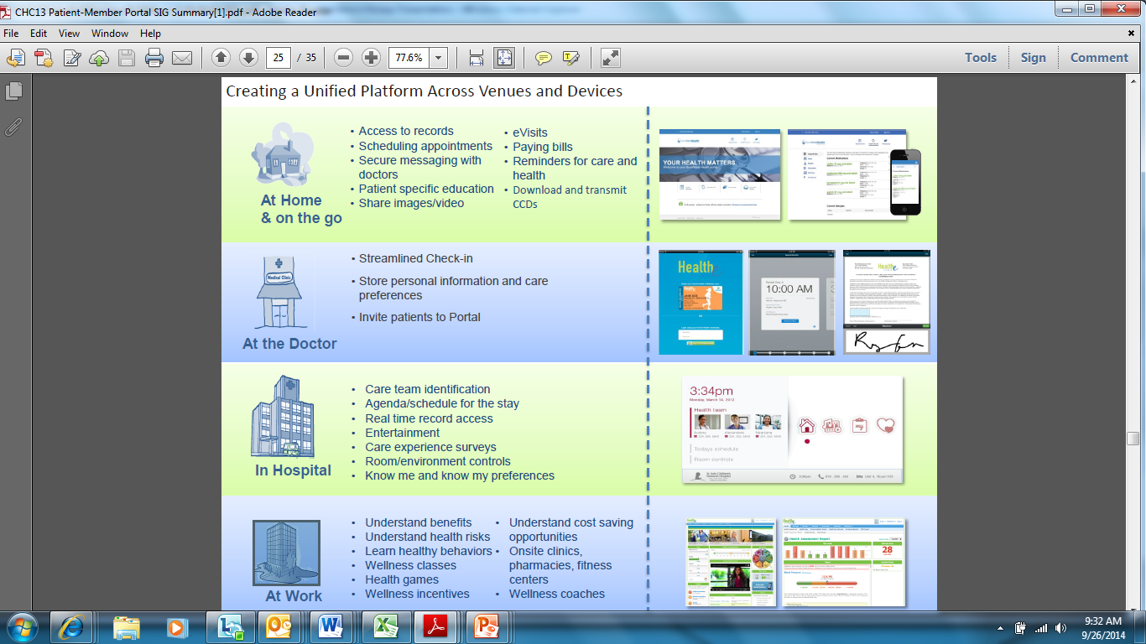

Slide 23
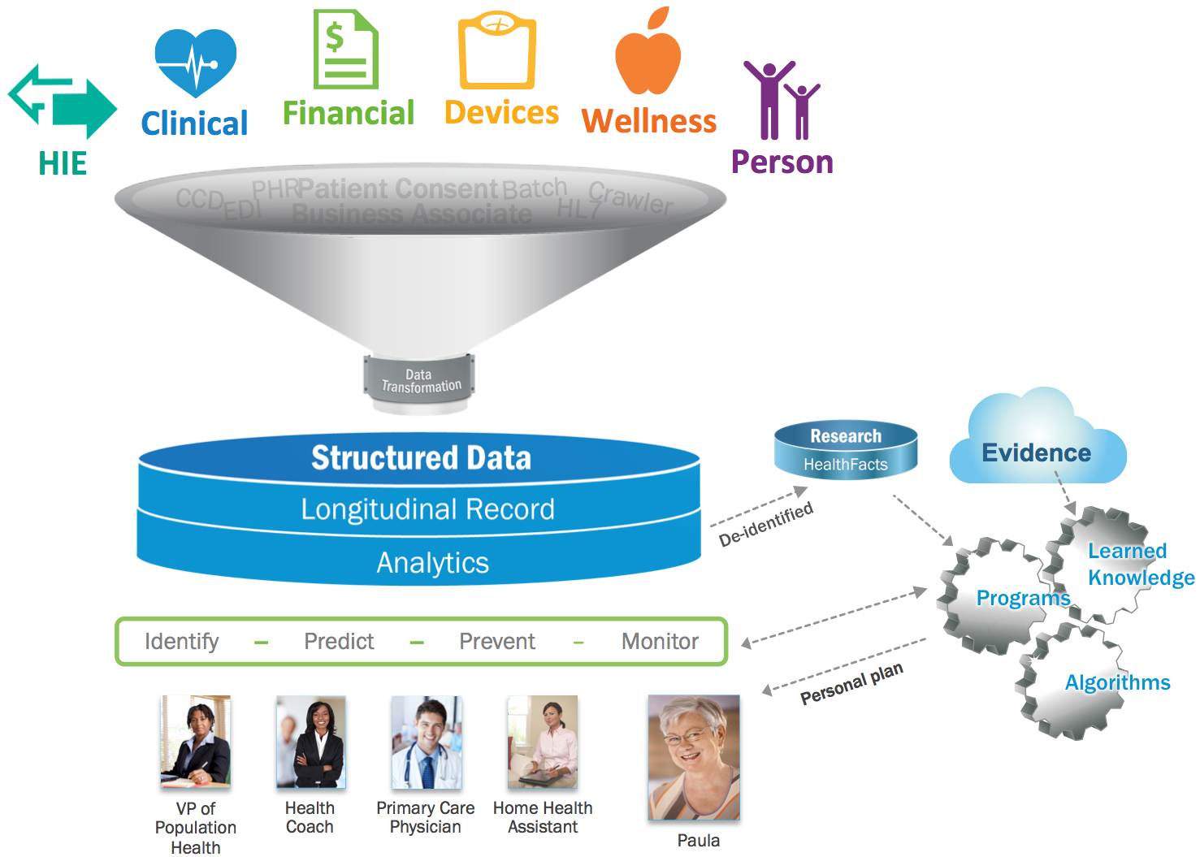
Know … and understand a population’s data
Health care organization use
our Healthe Intent platform to:
Aggregate, transform data
Identify, score and risk-stratify populations
Use predictive analytics
to identify and build the right programs, and actions
Reduce costs
Improve community health
Enable research
Notes:
The same as previous without animation.

Slide 24
Cerner Solutions & Services
Direct Care Systems
Departmental
Systems
Specialties
Business
& Operations
Knowledge
& Outcomes
Professional Services
Managed Services
Device Connectivity
Collaboration
Ambulatory
PowerChart
Ambulatory, Cerner
Practice
Management
EMR
PowerChart®,
Chart Search
Clinical
Laboratory
PathNet®
Rehabilitation
Registration
Management
Executable
Knowledge®
Learning
Services
Remote
Hosting
CernerWorks™
Device
Connectivity
Architecture
CareAware®
Online
Collaboration
uCern™
Homecare
HomeWorks®
RoadNotes®
Clinical
Documentation
CareNet®, PowerNote™,
PowerForms, CareCompass,
Care Management
Pathology
Laboratory
PathNet &
CoPathPlus®
Respiratory
Therapy
Scheduling
Management
Decision
Support
Clinical
Adoption
Services
Operational
Management
Services
CareAware
Modules
Links Solutions
Developer
Services
uDevelop™
Care Plans &
Protocol Mgmt.
PowerPlan™
Laboratory
Outreach
PathNet, Gajema®,
Cerner
WebConnect™
Cerner
Smart Room
Solutions
Health
Professions
Education
Long Term
Care
PowerChart® LTC
CareTracker®
MDS Intelligence
Laboratory
Outreach
PathNet, Outreach
Operations, Outreach
Physician Portal
Pediatrics
Benefits &
Eligibility
Management
Patient
Education
ExitCare, Krames
Implementation
Services
Application
Management
Services
CPOE
PowerOrders®
Cerner ePrescribe
Women’s Health
PowerChart
Maternity™
FetaLink®
FetaLink + ™
Pharmacy
PharmNet®
Inpatient, PharmNet
Outpatient, Etreby
Behavioral
Health
Millennium &
Community, Physical
Rehab
Enterprise
Master Person
Index
Reporting
PowerInsight®
Upgrade
Services
Disaster
Recovery
Medical
Device Resale
Academic
Education
Solution (AES)
Point of Care
Millennium
Point of Care™,
Cerner Bridge™
Emergency
FirstNet®
Medication
Dispensing
Cabinets
RxStation®
Member
Engagement &
Connectivity
Health
Information
Management
Clinical
Performance
Improvement
Lighthouse®
Enterprise Resource Planning
Support
Systems &
Services
Integrated Solutions
Critical Care
INet® Critical Care
INet Virtual™
CareAware Critical
Care™
Radiology
RadNet®
Document
Imaging &
Content Mgmt.
Content360™
Core Measures
Lighthouse
Athlete Health
HealtheAthlete™
Interoperability
Cerner Network
Core Measures
Lighthouse®
Regulatory &
Compliance
Practice
Implementation
Systems & Tools
Business
Continuity &
Storage
724Access®
Perioperative
SurgiNet®
& Anesthesia
Management
Cardiology
PowerChart,
Cardiovascular™
PowerChart ECG™
Personal
Health
Engagement
Cerner Patient Portal,
Cerner Wellness
Patient
Accounting
Critical Care
Outcomes
APACHE®
Outcomes
Outcome
Optimization
Lighthouse®
Issue Support
& Resolution
SolutionWorks
Infrastructure
& Operational
Management
Fitness Services
Olympus
Oncology
PowerChart
Oncology™
PACS
Cerner ProVision®
PACS
Employer
Services
On-Site Health
Centers, Pharmacies
Health & Wellness
Transaction
Services
Life Sciences
Drug Safety,
Discovere™ Late
Phase,
Health Facts®
Technology
Delivery
Services
Performance
Monitoring/
Best Practices
Lights On Network™
Ease of Use &
Security
Cerner Instant
Access™, P2Sentinel™,
PowerChart Touch™
Vendor Neutral
Archive
CareAware
MultiMedia™
Supply Chain
Management
Public Health
HealthSentry®
Testing Services
This chart is intended to provide a solid overview of the types of solutions and services Cerner offers. It is informative and not intended to be comprehensive of all Cerner solutions and services.
Workforce &
Capacity
Management
Clinical
Research
PowerTrials™,
Discovere,
Accountable for Health Services

Slide 25
